Slide 1
Bangladesh & Global Studies
Presentation on Khulna Division
Section : H
Presented to : Sariful Islam Sir
Spring Semester, 2026
AIUB

Slide 2
Team Members
Talha Faiyaz
Maahi Muhaimen Khan
Mayesha Samiha Oishee
Zinat Ilahi Ronok
Muftasin Fuad
Shakib Noor
Fariha Afrin
Seyam Rahman Nayem
Souvick Das Lobdhi
Ashraf Zaman Toufiq

Slide 3
Khulna History
Khulna is one of the major cities in south-western Bangladesh.
It is located near the Rupsha and Bhairab rivers and close to the Sundarbans mangrove forest.
Today it is an important industrial, river port, and educational center.

Slide 4
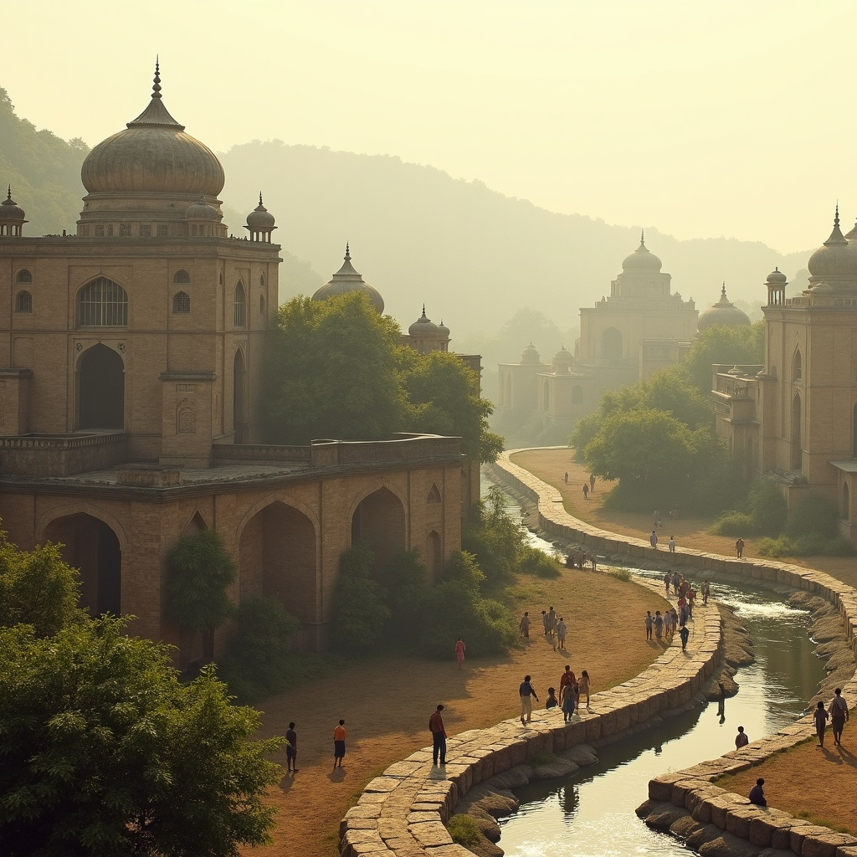
Ancient & Medieval History
The Khulna region was part of the ancient kingdoms of Vanga and Samatata.
In the 12th century, it came under the Sena Dynasty.
During the 14th–15th centuries, Muslim rulers and the famous saint Khan Jahan Ali developed the area and built many mosques and settlements.

Slide 5
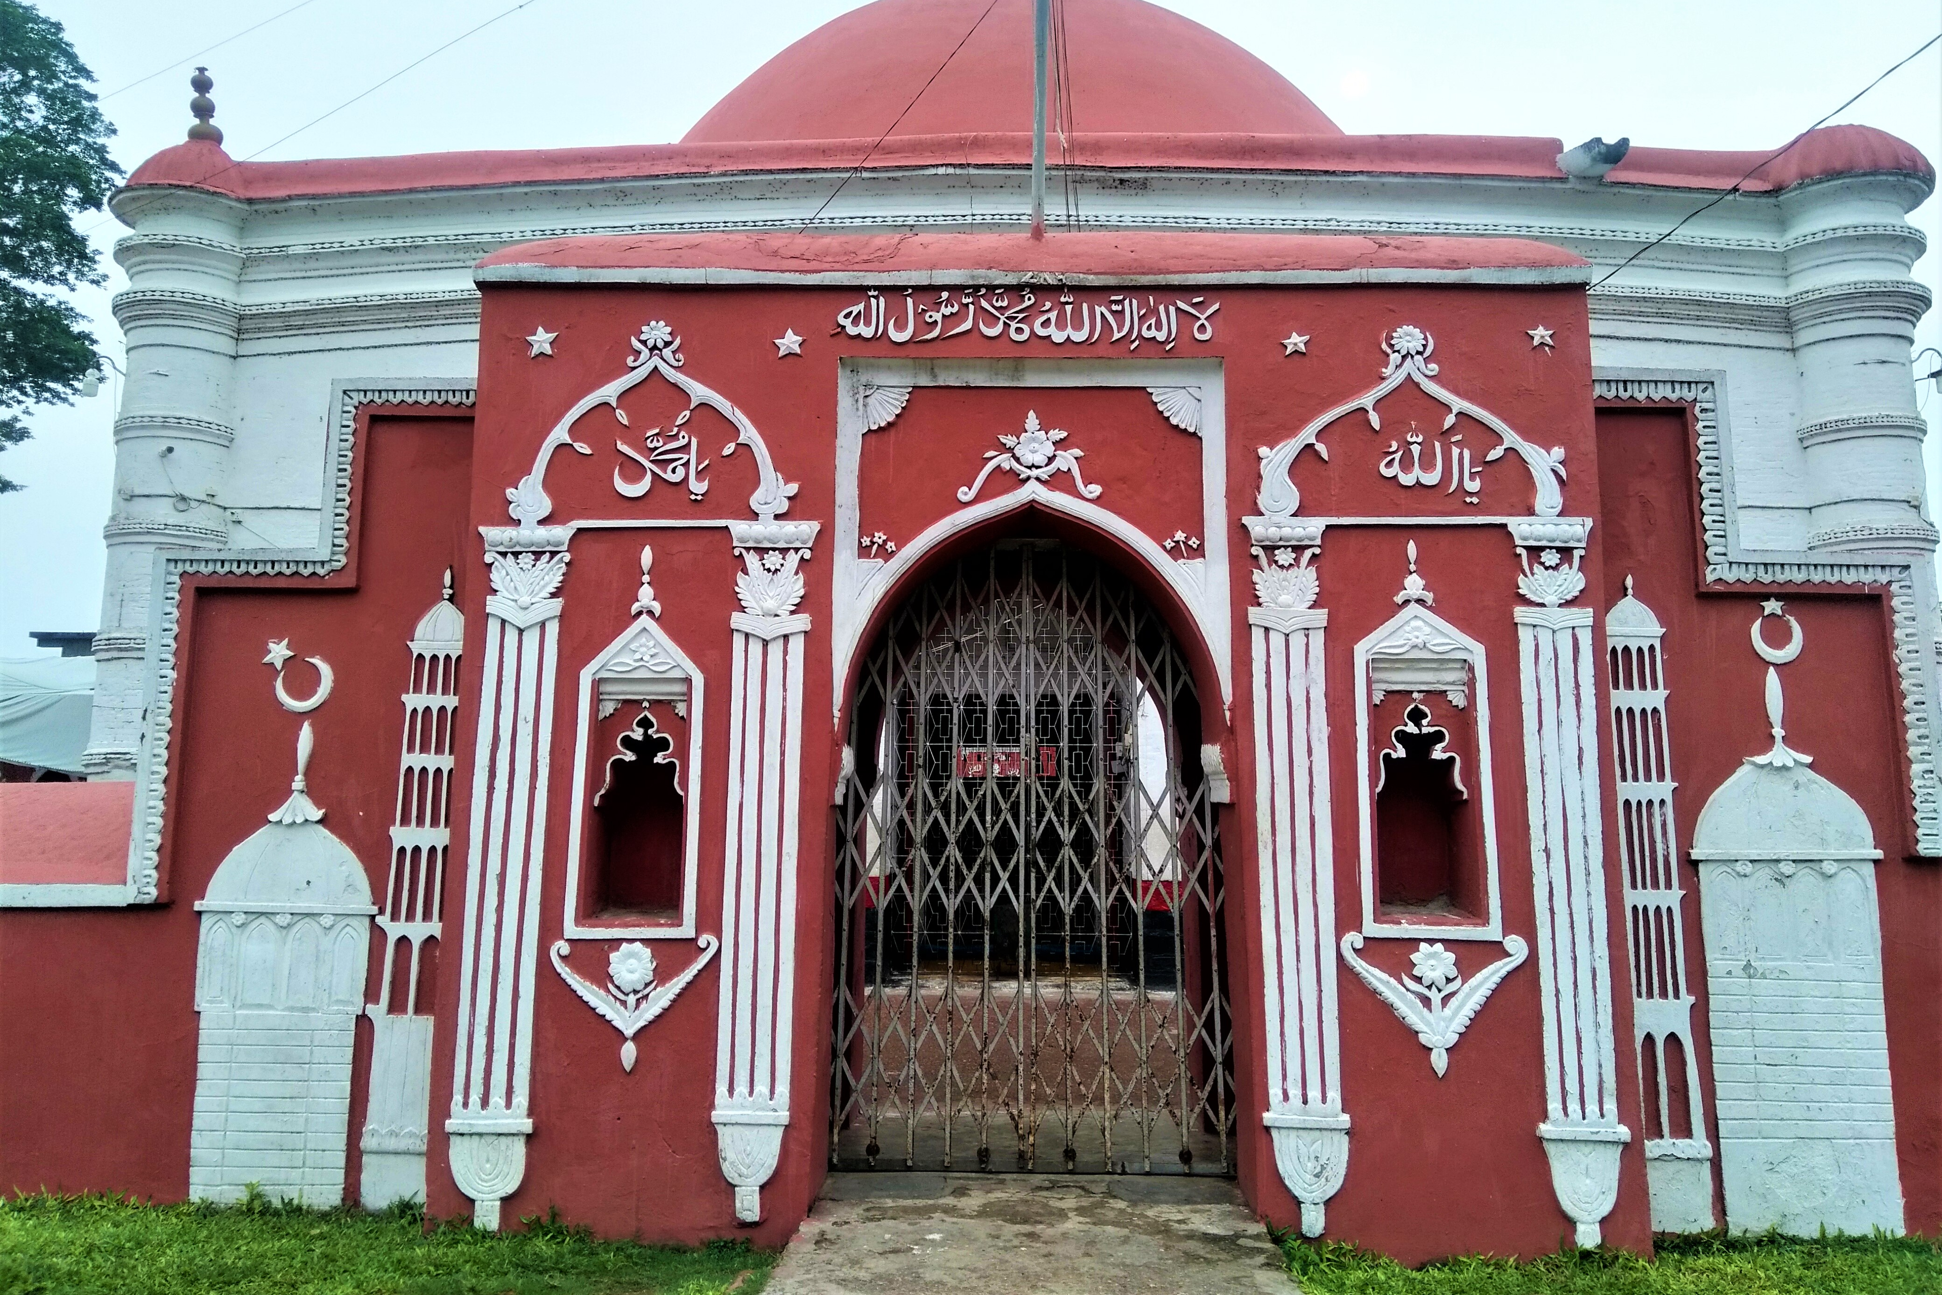
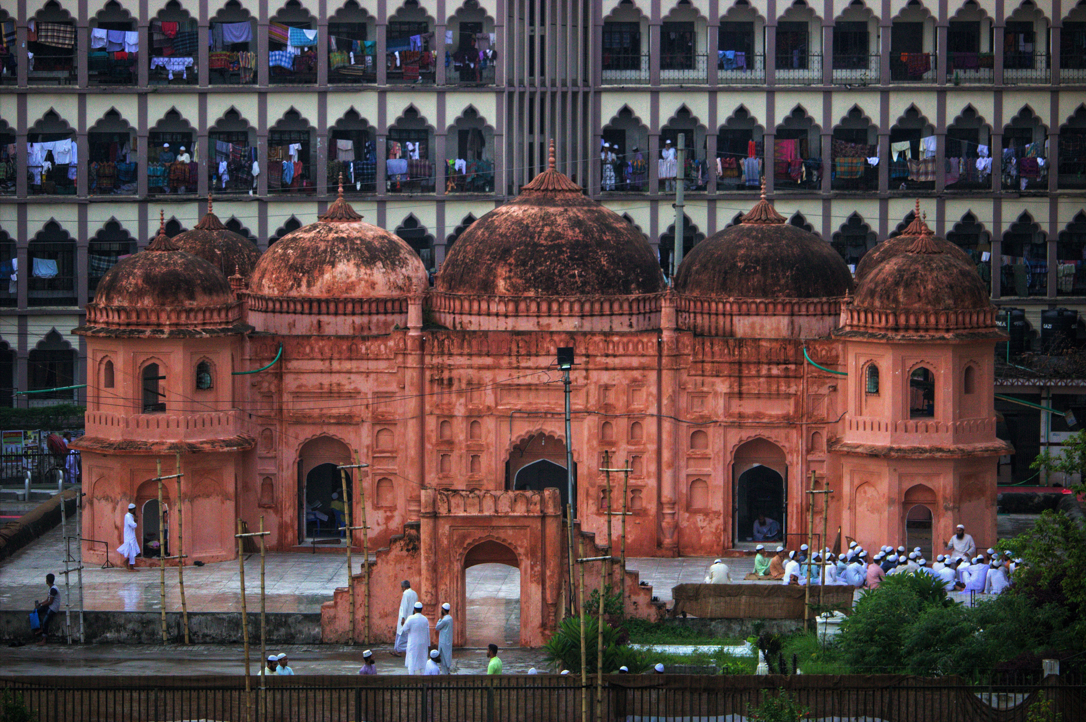
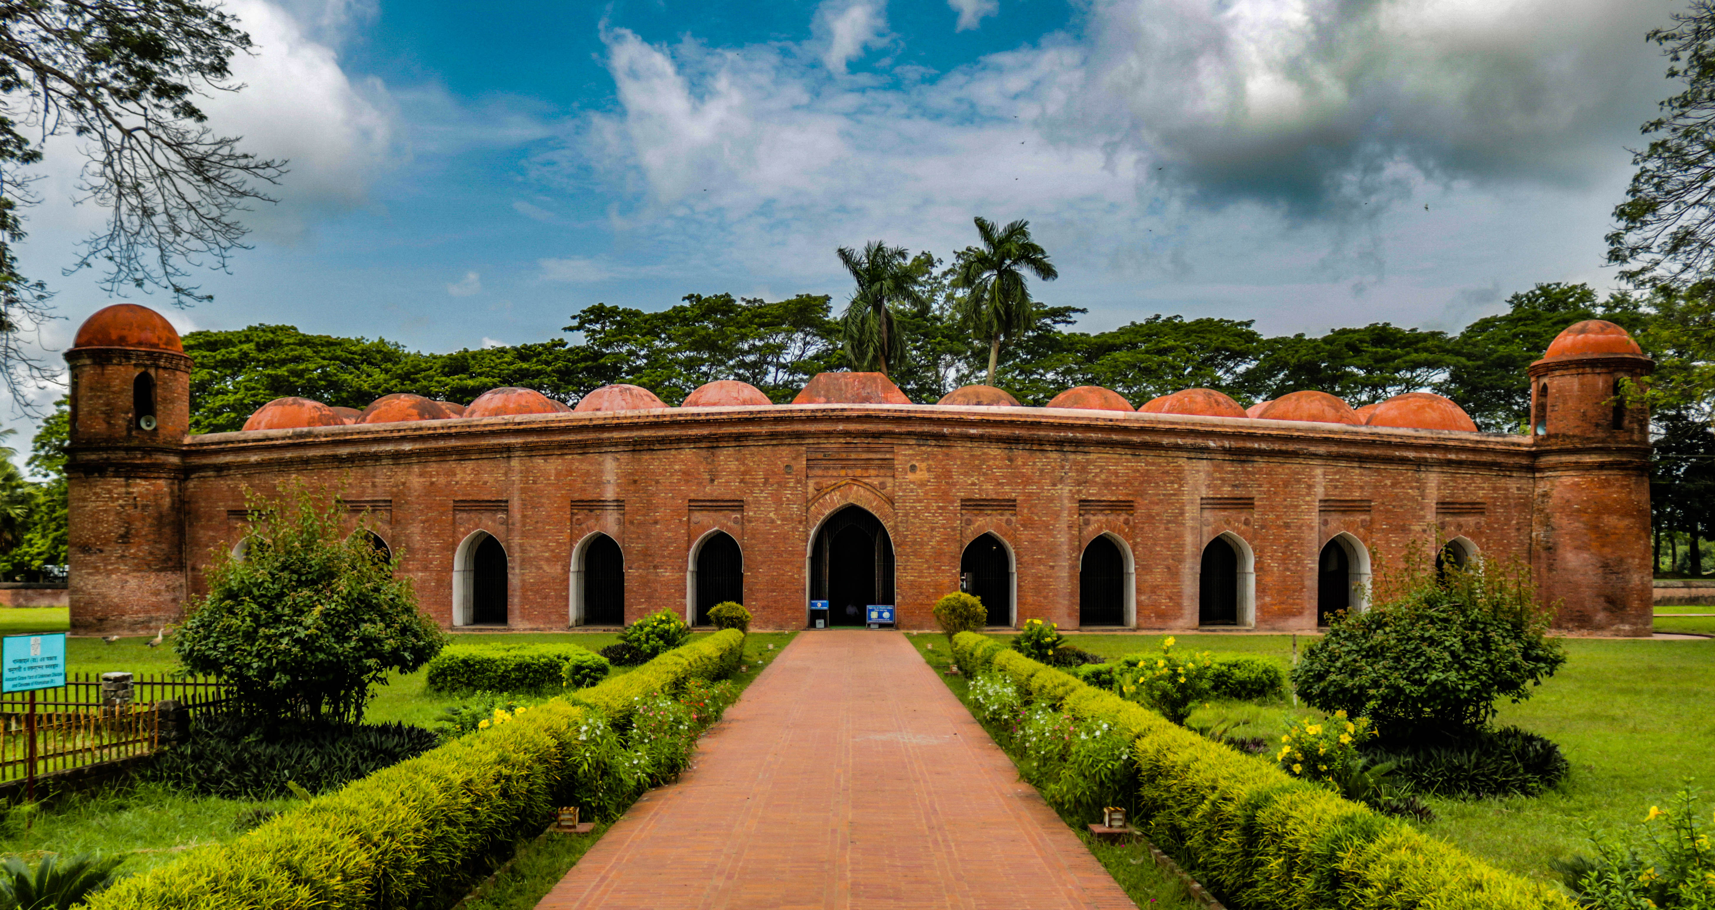
Mughal & British Period
In 1611, Mughal forces defeated the local ruler Pratapaditya.
The region became part of the Mughal Empire.
Later the British East India Company took control in the 18th century.
Khulna developed as an important river trade and port center.
Khulna became a municipality in 1884.

Slide 6
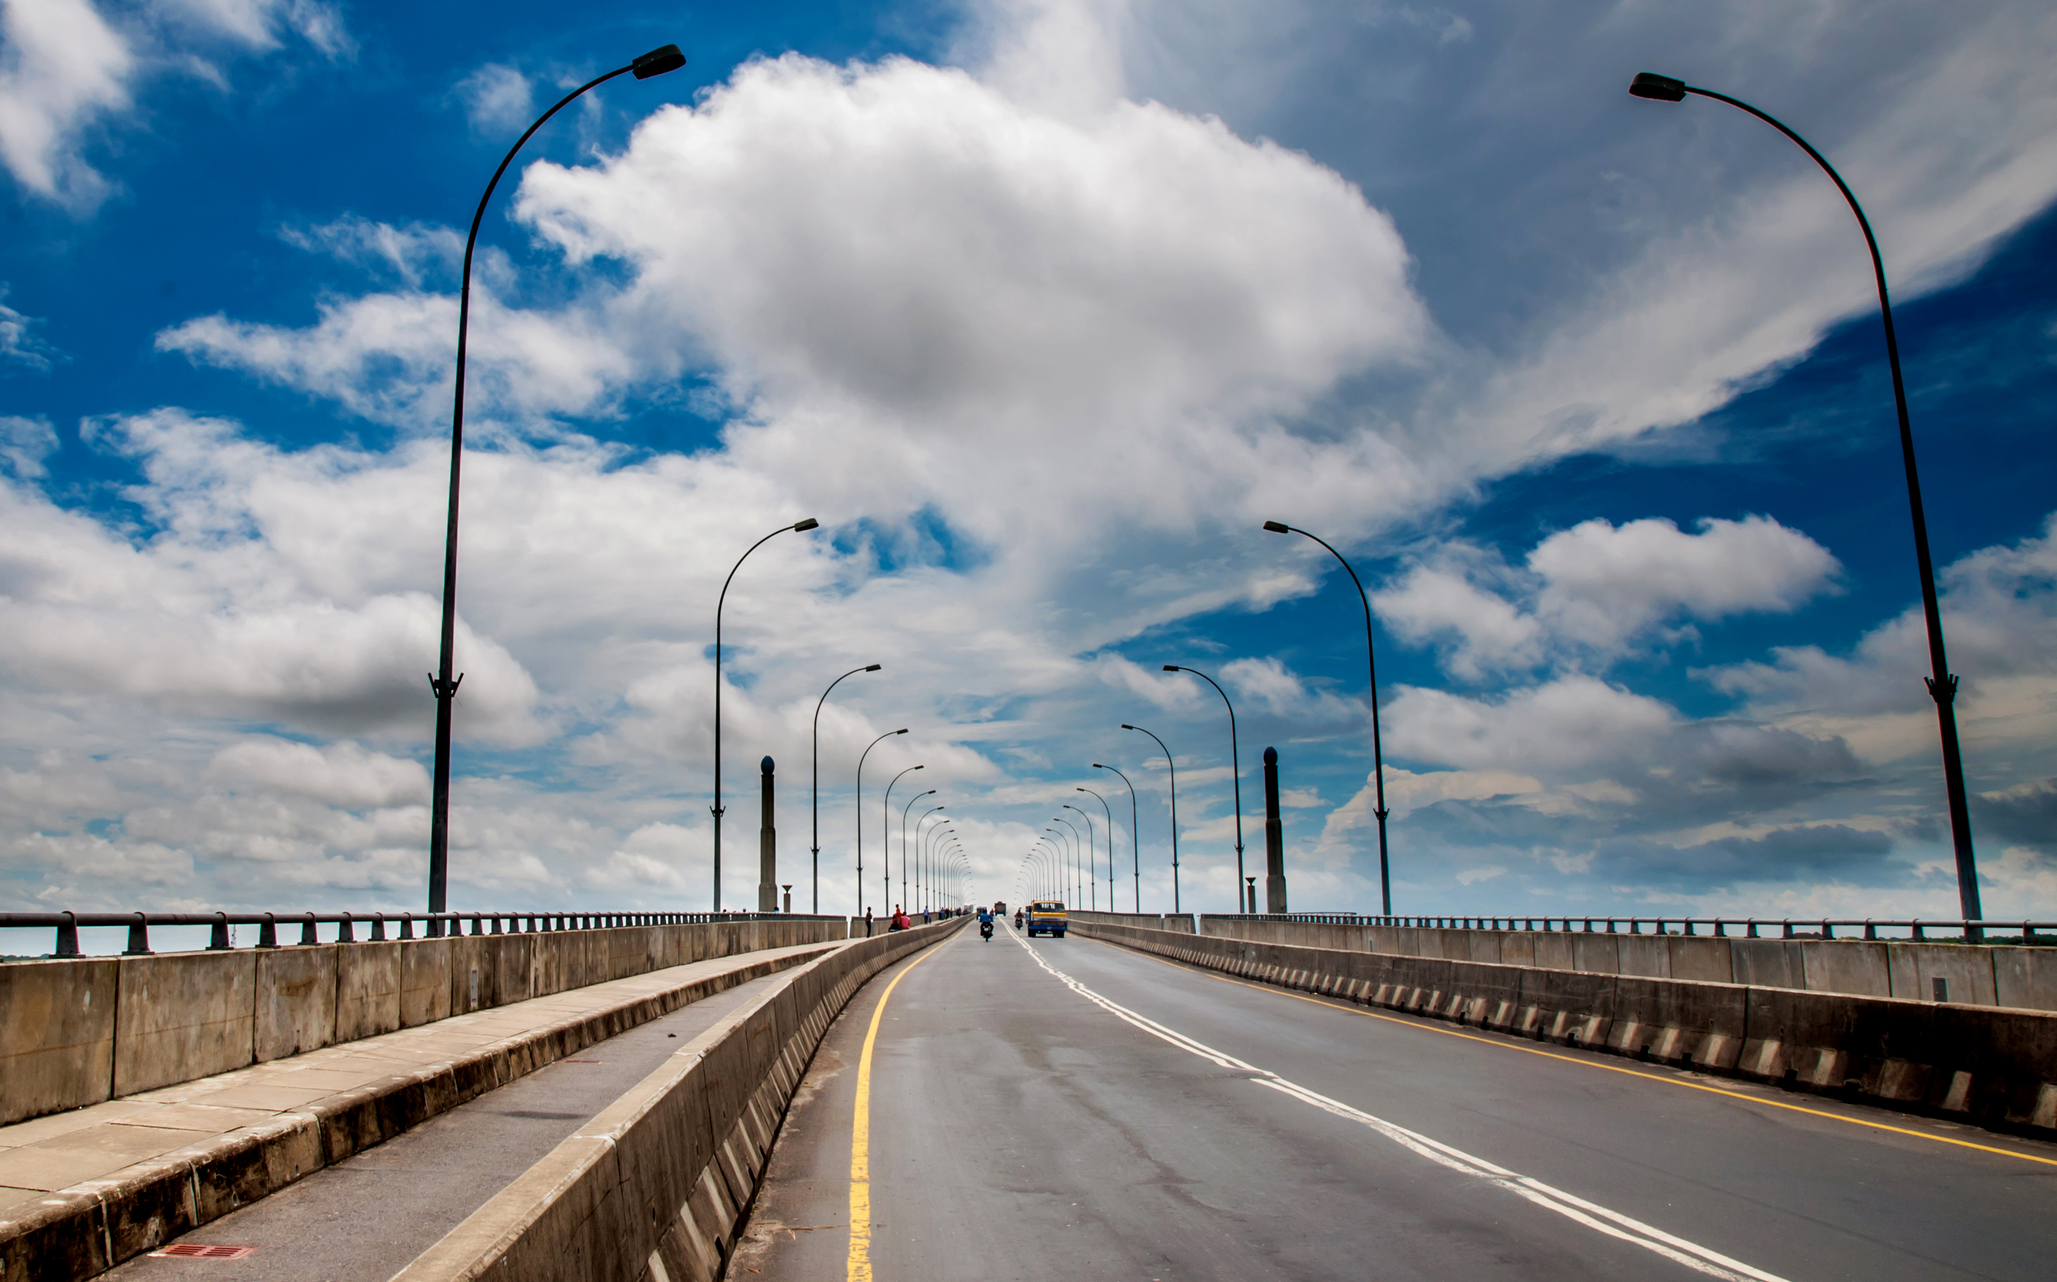
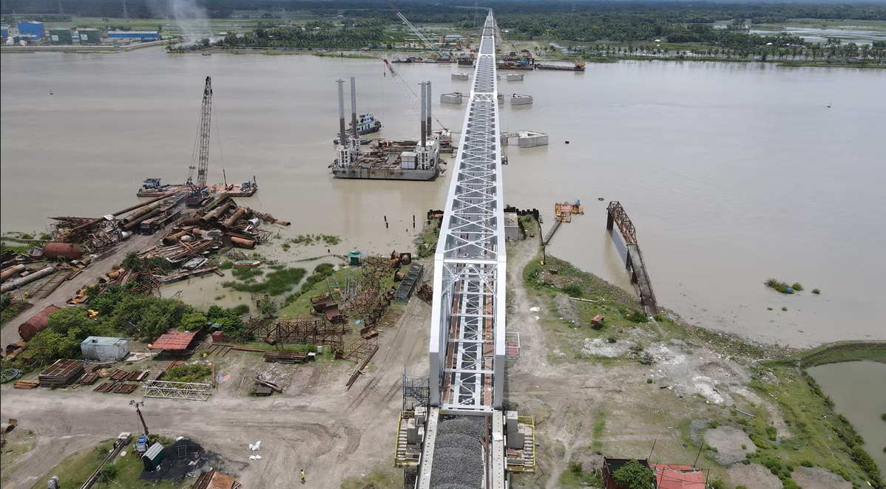
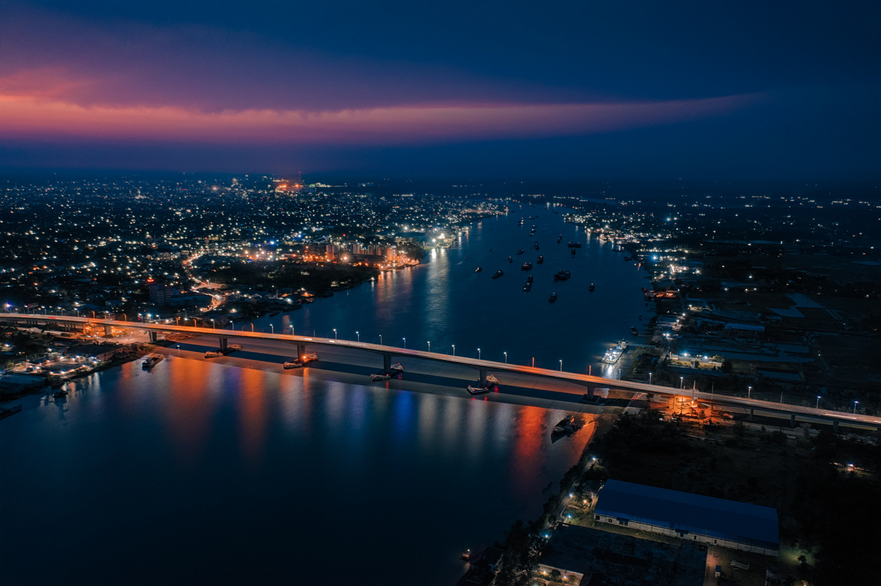
Modern History
Khulna played an important role during the 1971 Bangladesh -Liberation War.
The Chuknagar Massacre (1971) in Khulna was one of the largest massacres during the war.
Khulna became a City Corporation in 1990.
Today it is known as the “Gateway to the Sundarbans” and a major industrial city.

Slide 7
Administrative Structure of Khulna

Slide 9
Demography & Ethnic Communities

Slide 12
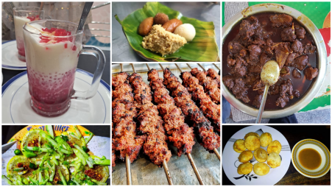
Culture
Strong rice‑ and fish‑based cuisine.
Famous for prawn and crab dishes from coastal and Sundarbans areas
Unique chui jhal (meat cooked with chui vine, very spicy and aromatic)
Seasonal pithas and sweets, especially in winter and around festivals.
Rich iftar and street‑food culture during Ramadan.

Slide 13
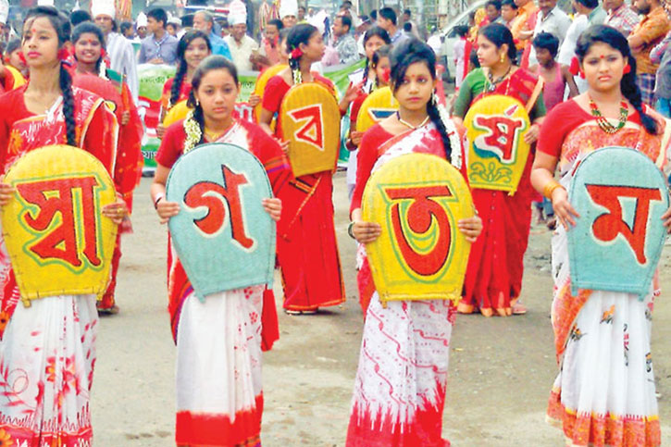
Fesitvals
Major religious festivals: Eid‑ul‑Fitr, Eid‑ul‑Adha, Durga Puja
Pahela Baishakh (Bengali New Year) celebrated with fairs and cultural programs.
Village melas with stalls, rides and folk performances
Traditional games during festivals (kabaddi, boat race, stick fighting in some areas)

Slide 14
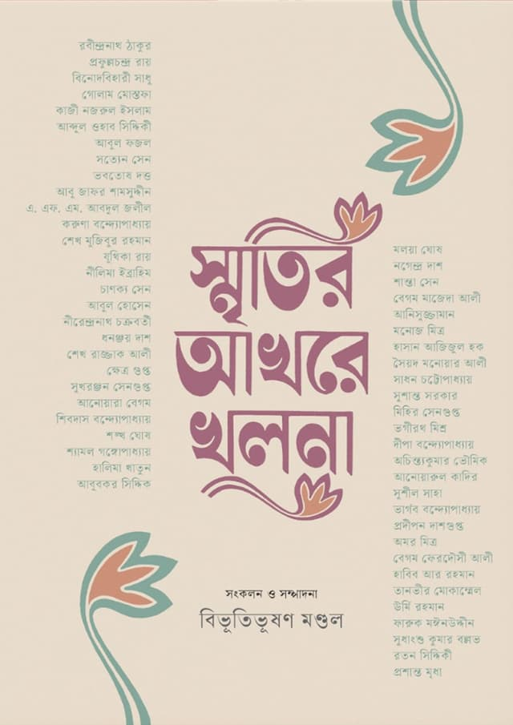
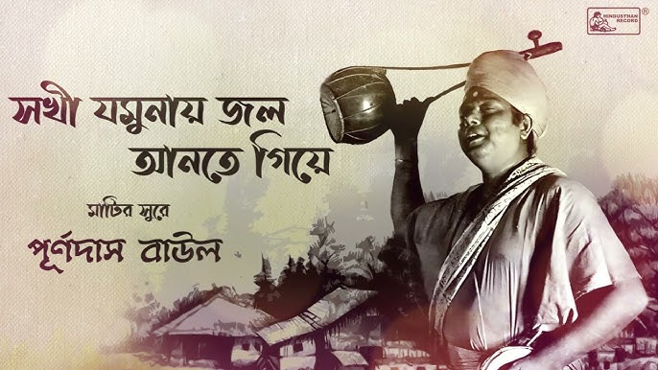
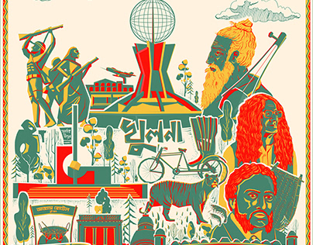
Art, Music & Literature
Folk traditions: Baul songs, Jari, Sari and Kirtan in rural and riverine areas
Nakshi kantha (embroidered quilts) made by rural women with story‑like motifs.
Little magazines, local newspapers and university journals promoting young authors

Slide 15
THANK YOU ALL FOR LISTENING.

